Slide 1

Disaster Avoidance is No Accident
An Introduction to Dynamic Risk Management
Notes:
Disaster Avoidance is No Accident - this phrase is true in life, and in investing, and is our constant goal. Today we will explore how the concept of Dynamic Risk Management helps us to achieve this goal.

Slide 2

“The essence of investment management is the management of risk, not the management of returns.”
~ Benjamin Graham
“The Dean of Wall Street”
Notes:
Ben Graham - known as “The Dean of Wall Street” during his lifetime - was a fabulously-successful investor, and a great teacher. In fact, Warren Buffet says everything he knows about investing he learned from Ben Graham. The most important lesson is that risk management is far, far more important than ‘just’ the pursuit of returns!

Slide 3

The industry-standard method
of managing risk in a client portfolio
is exemplified by the widely-used
“60/40 portfolio.”
Notes:
First, let's explore what the financial services industry standard practice is for Risk Management. It is the well-known and widely-used "60/40" portfolio.

Slide 4
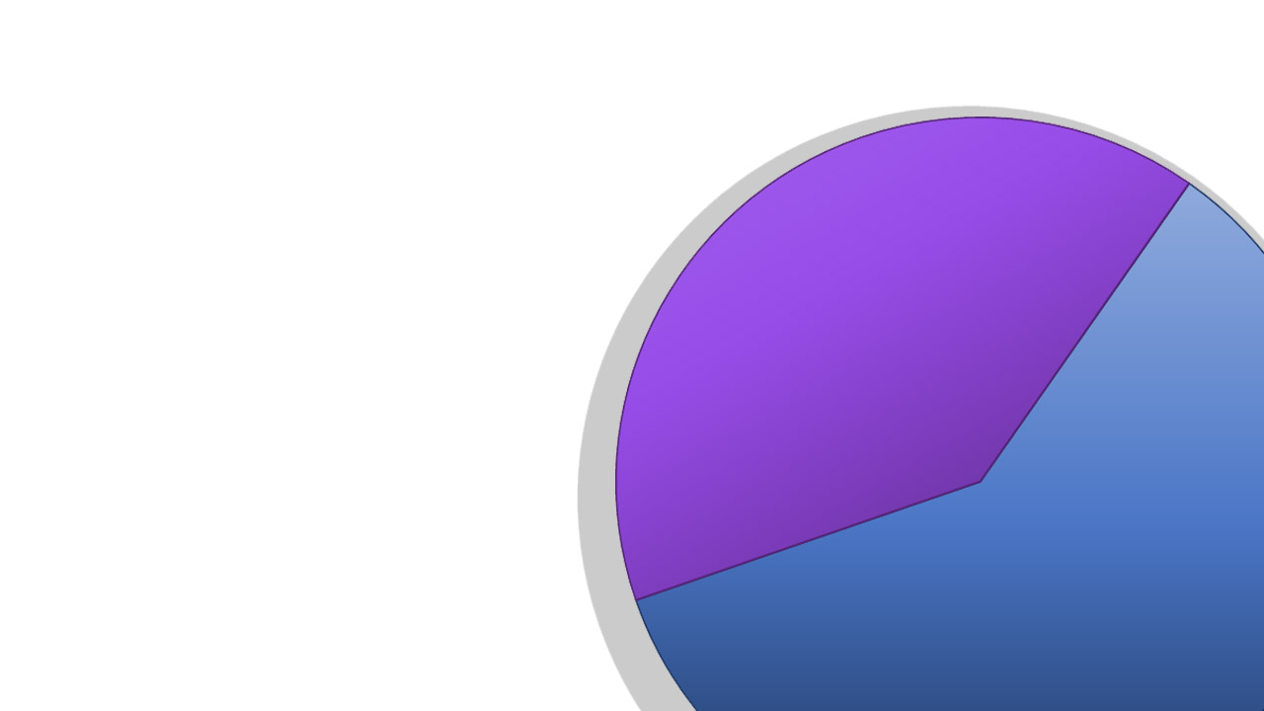
A 60/40 portfolio refers to a 60% allocation to stocks, and a 40% allocation to bonds.
The “risk management” is the 40% held in bonds, which are expected to act as a buffer to stocks during Bear markets, since bonds tend to hold up in times of stock distress.
40% Bonds
60% Stocks
Notes:
The "Risk Management" embodied in the industry-standard 60/40 portfolio is found in the 40% bond portion, which is always present and intended to act as a buffer against the higher volatility and larger potential losses of the stock portion.

Slide 5

40% Bonds
The 60/40 has become such an industry standard, in fact, that it’s frequently known as
“The Balanced Portfolio”
“The Balanced Portfolio”
The Balanced Portfolio
60% Stocks

Slide 6

The 60/40 portfolio is so common that investors can find a Balanced Fund by throwing a dart at the mutual funds page of their Sunday newspapers.

Slide 7
There are actually hundreds of Balanced Funds available anymore - including many whose names you may recognize, like these:
Vanguard Balanced Index
American Funds Balanced
Dodge & Cox Balanced
T. Rowe Price Balanced
Fidelity Balanced
Notes:
There are hundreds of Balanced Funds available; here are just a few of the more prominent examples.

Slide 8
This passive, fixed, unchanging method of risk management is called
STATIC
risk management.
Notes:
We call this fixed, constant, unchanging approach to risk management ..."Static Risk Management".

Slide 9

But, does a STATIC 60/40 portfolio really provide the desired outcome?
Notes:
But we have to ask the question: Does the industry-standard 60/40 portfolio really provide the level of risk management that average investors expect it to? Does it really limit the damage that big declines in stock values can inflict on a portfolio, as one would expect?

Slide 10
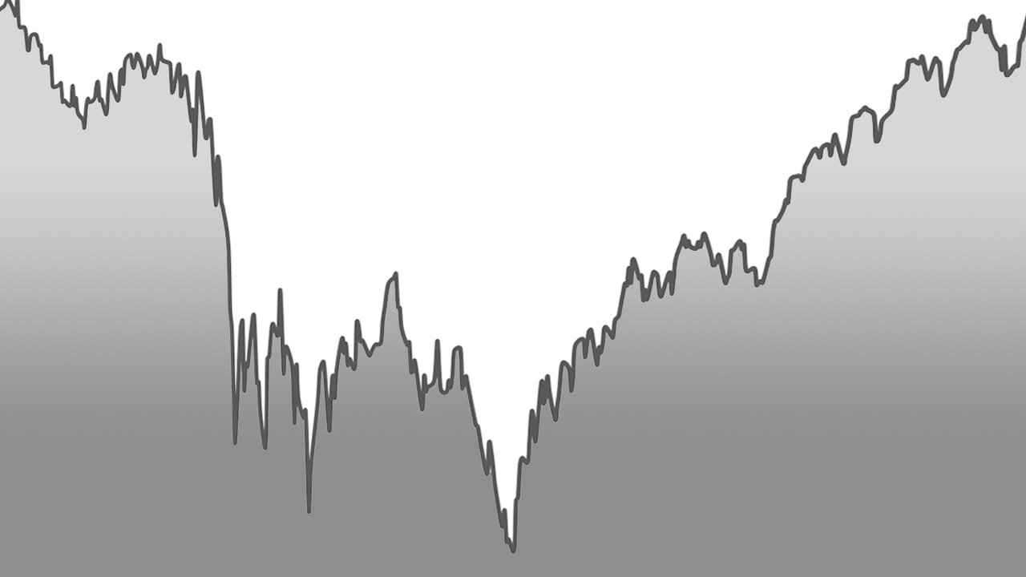
The answer is, “NO!”
In a Bear Market, when risk and losses are high, static risk-management measures are not enough …
… but in a Bull Market, when stock risk is low, these static risk-management measures are too much.
Notes:
(slide text)

Slide 11

If you think about it, a STATIC portfolio - with its constant, unchanging allocations to stocks and bonds - is a bit like preparing for any weather you might encounter by dressing in a constant, unchanging set of clothes, like this guy.
Dressed for all conditions, but prepared for none!

Slide 12

As you can see, he has allocated 60% of his wardrobe for blue skies and sunshine, and 40% for a life-threatening blizzard.
And as you can imagine, his wardrobe, in reality, is unsuitable for either condition.

Slide 13
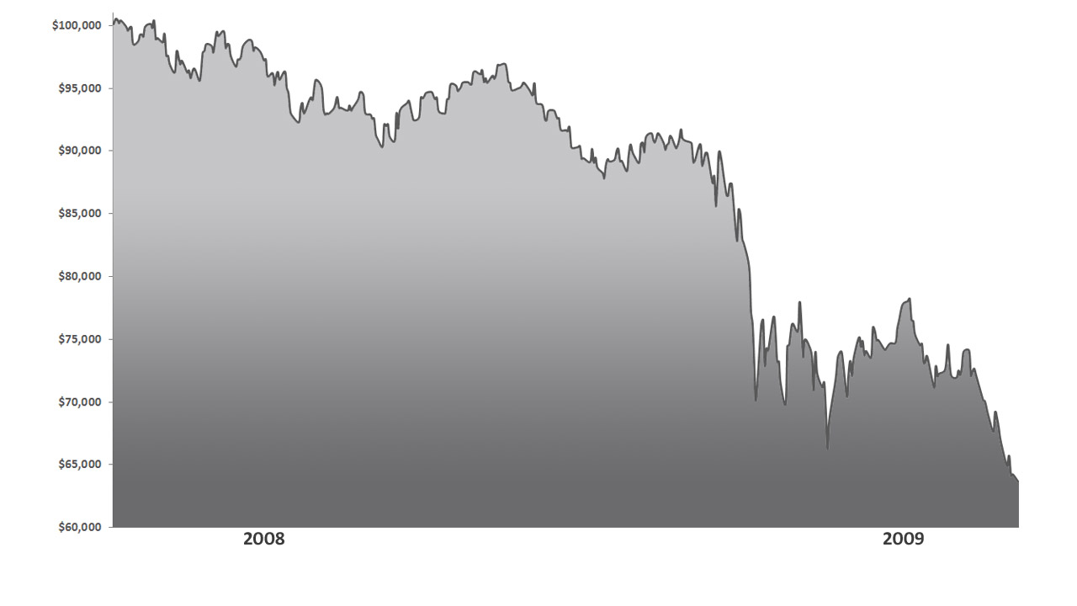
STATIC 60/40 Portfolio*
60% S&P 500 Total Return Index*
40% Barclays Aggregate Bond Index*
October 7, 2007 – March 9, 2009
If we construct a static risk managed balanced portfolio of 60% stocks and 40% bonds, we get a top-to-bottom loss in the 2008 and 2009 bear market of -34.70%.
This loss is well beyond the risk tolerance capacity of the vast majority of investors, and would be deemed a disaster by any reasonable person.
-34.70%
The S&P 500 Total Return Index is the price return of the Standard & Poor's 500 Index, including daily reinvestment of dividends. It generally represents the aggregate price changes in the largest 500 US publicly traded companies, in addition to the reinvestment of the dividends that those companies pay. The Barclays US Aggregate Bond Index is a broad-based benchmark that measures the investment grade, US dollar-denominated, fixed-rate taxable bond market including Treasuries, government-related, corporate and other securities. The STATIC 60/40 Portfolio consists of a 60% allocation to the S&P Total Return Index, and a 40% allocation to the Barclays Aggregate Bond Index. Historical returns data has been compiled using price data provided by exchanges and not from actual accounts, and should therefore be considered to be hypothetical. Past performance is no guarantee of future results.
Notes:
The industry-standard 60/40 portfolio is modeled here by 60% of the S&P 500 Total Return Index, and 40% of the Barclays Aggregate Bond Index..
This 60/40 portfolio lost almost 35% from the high in late 2007 to the low in early 2009. This loss far exceeds any reasonable person's expectation of a "risk-managed" portfolio!

Slide 14
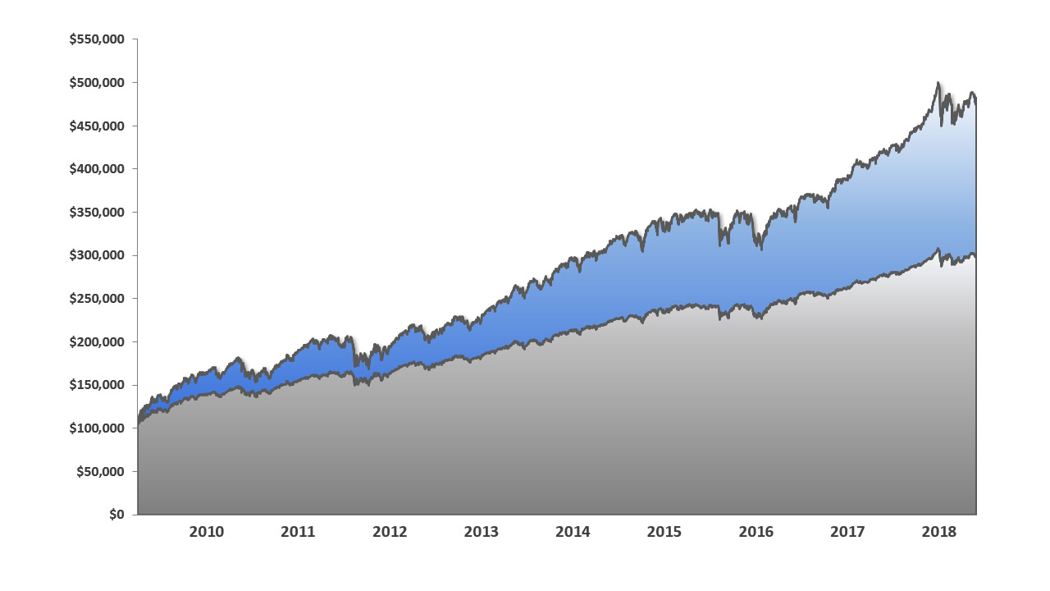
Additionally, in the subsequent up-years in the market, this allocation wouldn’t have performed as well as it could have because of the drag on performance caused by the 40% bond allocation.
S&P 500 Total Return Index*
STATIC 60/40*
STATIC 60/40 Portfolio* vs. S&P 500 Total Return Index*
March 9, 2009 – June 29, 2018
The S&P 500 Total Return Index is the price return of the Standard & Poor's 500 Index, including daily reinvestment of dividends. It generally represents the aggregate price changes in the largest 500 US publicly traded companies, in addition to the reinvestment of the dividends that those companies pay. The Barclays US Aggregate Bond Index is a broad-based benchmark that measures the investment grade, US dollar-denominated, fixed-rate taxable bond market including Treasuries, government-related, corporate and other securities. The STATIC 60/40 Portfolio consists of a 60% allocation to the S&P Total Return Index, and a 40% allocation to the Barclays Aggregate Bond Index. Historical returns data has been compiled using price data provided by exchanges and not from actual accounts, and should therefore be considered to be hypothetical. Past performance is no guarantee of future results.

Slide 15
Since the stock market lows of March 9, 2009, the STATIC 60/40 portfolio* would have generated an annual return of 12.5% per year, but the S&P 500* would have returned 18.3% per year.
S&P 500 Total Return Index*
+18.30%/yr.
STATIC 60/40*
+12.50%/yr.
STATIC 60/40 Portfolio* vs. S&P 500 Total Return Index*
March 9, 2009 – June 29, 2018
The S&P 500 Total Return Index is the price return of the Standard & Poor's 500 Index, including daily reinvestment of dividends. It generally represents the aggregate price changes in the largest 500 US publicly traded companies, in addition to the reinvestment of the dividends that those companies pay. The Barclays US Aggregate Bond Index is a broad-based benchmark that measures the investment grade, US dollar-denominated, fixed-rate taxable bond market including Treasuries, government-related, corporate and other securities. The STATIC 60/40 Portfolio consists of a 60% allocation to the S&P Total Return Index, and a 40% allocation to the Barclays Aggregate Bond Index. Historical returns data has been compiled using price data provided by exchanges and not from actual accounts, and should therefore be considered to be hypothetical. Past performance is no guarantee of future results.

Slide 16
As you can see, STATIC risk management would have supplied too little protection in the bad times, but too much in the good times. The goal of Dynamic Risk Management is to apply more
in the bad times - when need is greatest - and less in
the good times - when the need is reduced.
S&P 500 Total Return Index*
+18.30%/yr.
STATIC 60/40*
+12.50%/yr.
STATIC 60/40 Portfolio* vs. S&P 500 Total Return Index*
March 9, 2009 – June 29, 2018
The S&P 500 Total Return Index is the price return of the Standard & Poor's 500 Index, including daily reinvestment of dividends. It generally represents the aggregate price changes in the largest 500 US publicly traded companies, in addition to the reinvestment of the dividends that those companies pay. The Barclays US Aggregate Bond Index is a broad-based benchmark that measures the investment grade, US dollar-denominated, fixed-rate taxable bond market including Treasuries, government-related, corporate and other securities. The STATIC 60/40 Portfolio consists of a 60% allocation to the S&P Total Return Index, and a 40% allocation to the Barclays Aggregate Bond Index. Historical returns data has been compiled using price data provided by exchanges and not from actual accounts, and should therefore be considered to be hypothetical. Past performance is no guarantee of future results.

Slide 17
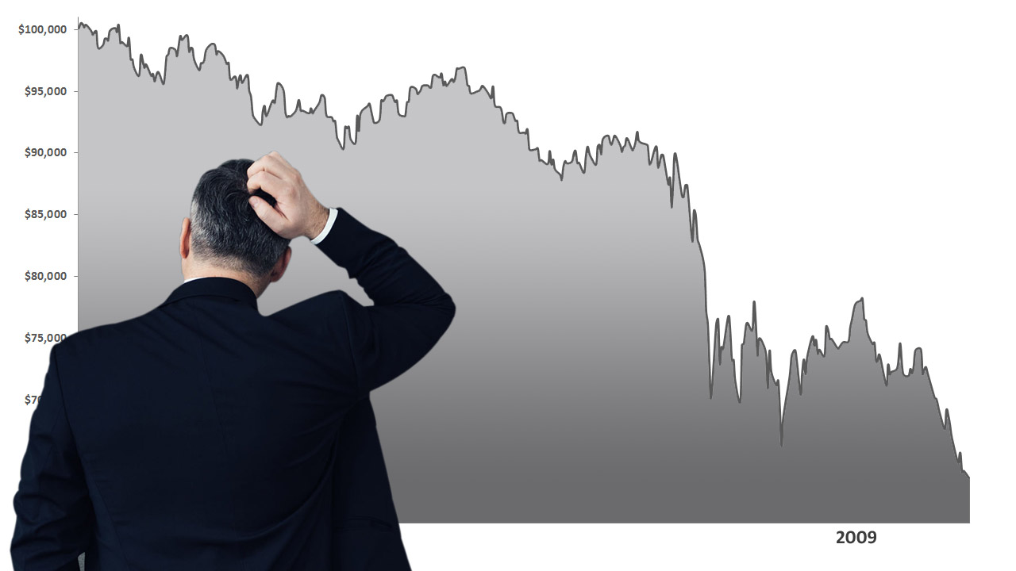
So the obvious question is, how can you accurately identify the conditions at which more or less risk management should be applied?
Notes:
So this is the big question: Is it possible to identify the times when MORE risk management should be applied, and the times when LESS risk management should be applied?

Slide 18

One way is the Market Condition Identification method.
This method combines a quantitative, fact-based assessment of three different market timeframes to determine overall market health.
Short-term (weeks-to-months)
Medium-term (quarter-by-quarter)
Long-term (months-to-years)
Notes:
We think the answer is "YES!", using our Market Condition Identification method.

Slide 19

The sum of positive timeframes determines the Market Condition reading:
NEGATIVE, NEUTRAL or POSITIVE

Slide 20
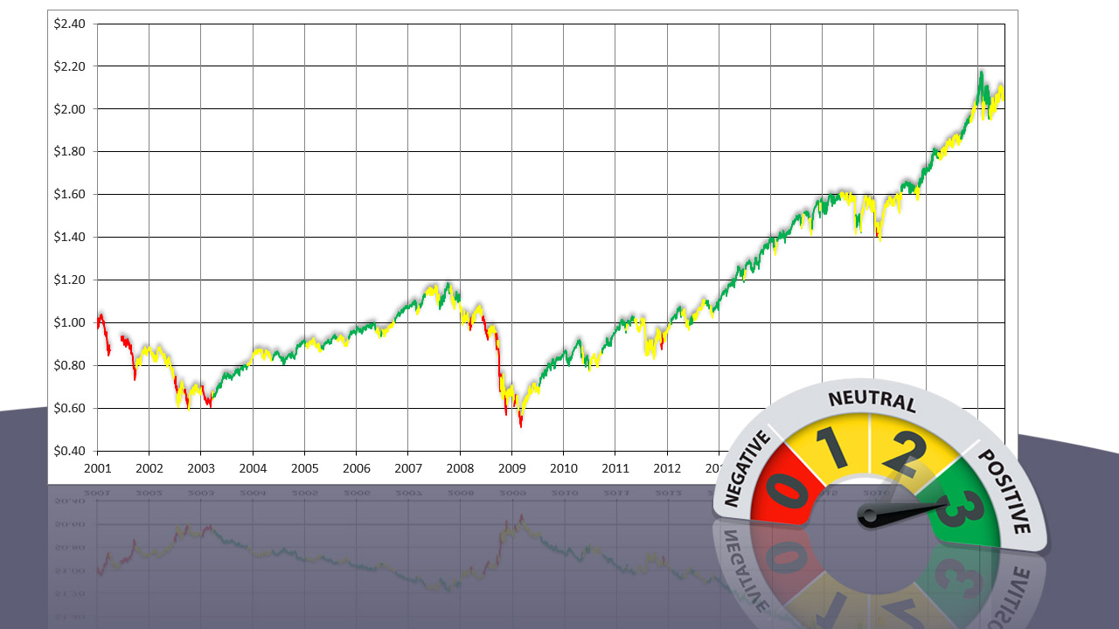
Market Condition
S&P 500* Jan. 1, 2001 – June 29, 2018
SUM OF POSITIVE TIMEFRAMES
SHORT - MEDIUM - LONG
* The S&P 500 is an unmanaged market capitalization-weighted index of 500 common stocks chosen for market size, liquidity, and industry group representation to represent U.S. equity performance. One cannot invest directly in an index. Past performance is no guarantee of future results.
Notes:
As you can see on this chart, the market declines are dominated by yellow and red periods, while the market uptrends are dominated by green, with a smattering of yellow.

Slide 21
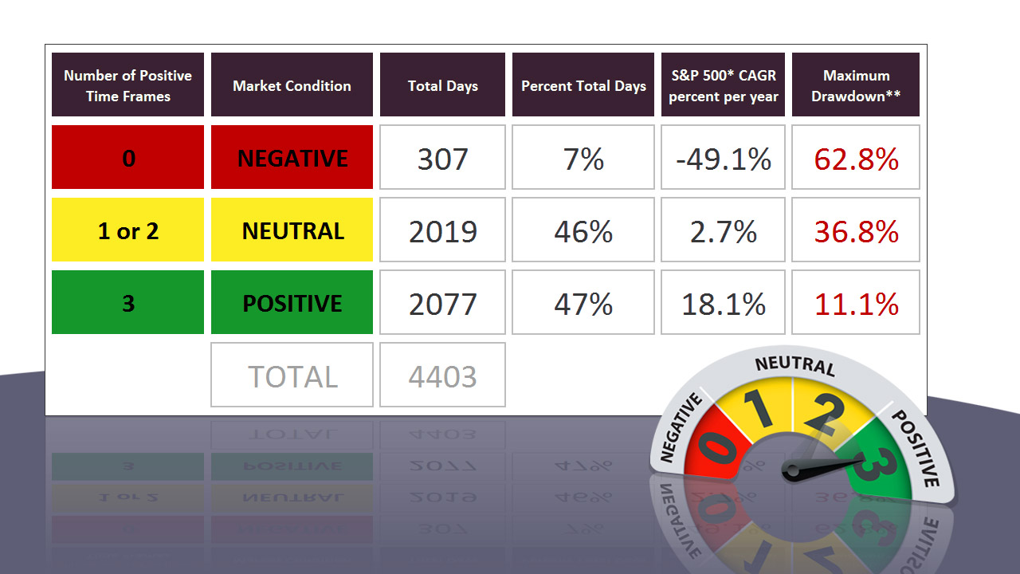
S&P 500* Annual Return and Drawdown by Market Condition
January 1, 2001 through June 29, 2018
* The S&P 500 is an unmanaged market capitalization-weighted index of 500 common stocks chosen for market size, liquidity, and industry group representation to represent U.S. equity performance. One cannot invest directly in an index. CAGR = Compound Annual Growth Rate. ** Maximum Drawdown is the maximum loss from a peak to a trough of a portfolio, before a new peak is attained. Historical returns data has been compiled using price data provided by exchanges and not from actual accounts, and should therefore be considered to be hypothetical. Past performance is no guarantee of future results.
Notes:
These statistics show how powerful the Market Condition Identification system is.

Slide 22
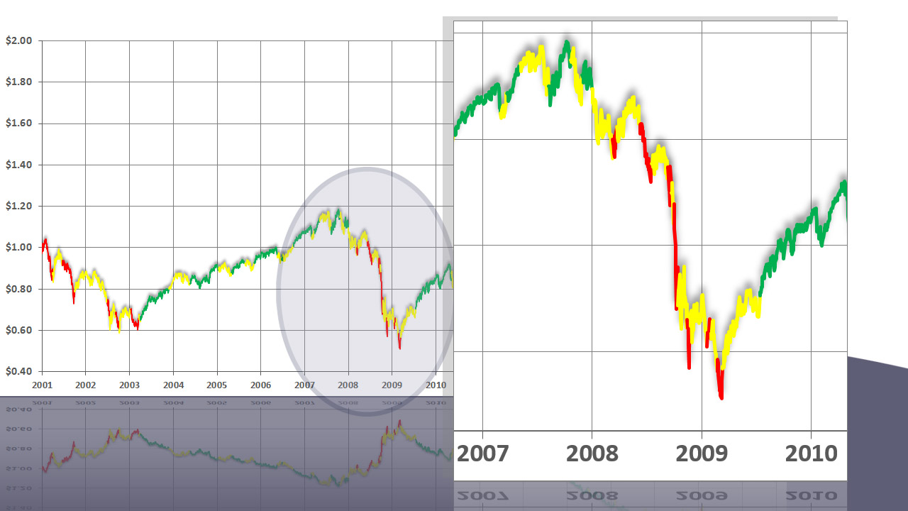
Market Condition
S&P 500 2001 – June 29, 2018
SUM OF POSITIVE TIME FRAMES
SHORT - MEDIUM - LONG
During the financial crisis of 2008-2009 the STATIC 60/40 portfolio* would have maintained its constant 60% stock allocation. Dynamic Risk Management, however, would have been heightened - i.e., in maximum risk-management mode - through the entire plunge.
The STATIC 60/40 Portfolio consists of a 60% allocation to the S&P Total Return Index, and a 40% allocation to the Barclays Aggregate Bond Index. The S&P 500 Total Return Index is the price return of the Standard & Poor's 500 Index, including daily reinvestment of dividends. It generally represents the aggregate price changes in the largest 500 US publicly traded companies, in addition to the reinvestment of the dividends that those companies pay. The Barclays US Aggregate Bond Index is a broad-based benchmark that measures the investment grade, US dollar-denominated, fixed-rate taxable bond market including Treasuries, government-related, corporate and other securities. ** The Dynamic Risk Managed Example Portfolio uses S&P 500 Total Return Index during "Positive" market conditions, and a group of three Bond sector ETFs during "Neutral" and "Negative" market conditions. The Bond sectors are selected by the Multi-Sector Bond Model published by The Sherman Sheet.TM Dividends are reinvested. Returns are hypothetical and do not include any fees. Past performance is no guarantee of future results.
Notes:
As we zero-in on the disastrous decline from late 2007 to early 2009, you can see a "Heightened" (yellow) or "Maximum" (red) risk-management mode, for the entire period!

Slide 23
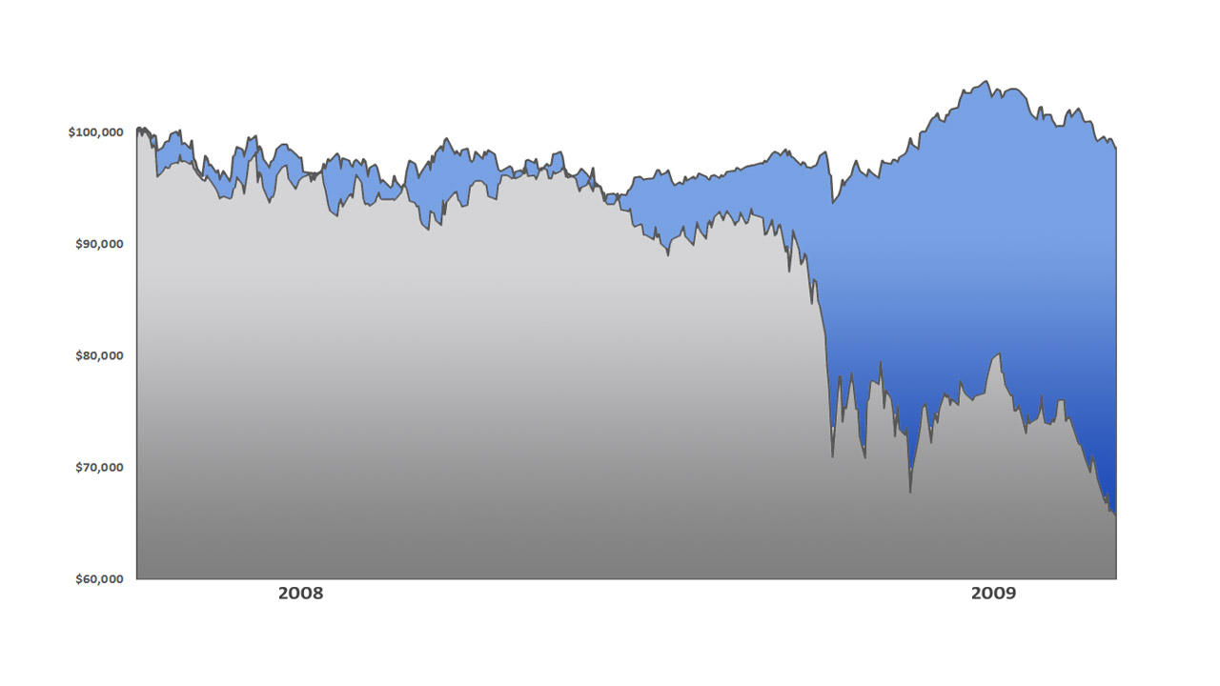
STATIC 60/40 Portfolio* vs.
Dynamic Risk-Managed Example Portfolio**
October 7, 2007 – March 9, 2009
Dynamic Risk Managed Example**
-6.77%
“max loss”
Where the STATIC 60/40 portfolio* suffered a 34.7% loss during this period, a Dynamic Risk Managed** strategy simply using bond holdings during neutral and negative market conditions experienced a modest -6.77% maximum decline, and actually finished the period with only a small loss of -1.63%.
STATIC 60/40*
-34.70%
“max loss”
The STATIC 60/40 Portfolio consists of a 60% allocation to the S&P Total Return Index, and a 40% allocation to the Barclays Aggregate Bond Index. The S&P 500 Total Return Index is the price return of the Standard & Poor's 500 Index, including daily reinvestment of dividends. It generally represents the aggregate price changes in the largest 500 US publicly traded companies, in addition to the reinvestment of the dividends that those companies pay. The Barclays US Aggregate Bond Index is a broad-based benchmark that measures the investment grade, US dollar-denominated, fixed-rate taxable bond market including Treasuries, government-related, corporate and other securities. ** The Dynamic Risk Managed Example Portfolio uses S&P 500 Total Return Index during "Positive" market conditions, and a group of three Bond sector ETFs during "Neutral" and "Negative" market conditions. The Bond sectors are selected by the Multi-Sector Bond Model published by The Sherman Sheet.TM Dividends are reinvested. Historical returns data has been compiled using price data provided by exchanges and not from actual accounts, and should therefore be considered to be hypothetical. Past performance is no guarantee of future results.
Notes:
In fact, Dynamic Risk Management is so effective, that the maximum loss would have been a tiny -6.77% versus the -34.7% maximum loss for the industry-standard Static Risk Management solution. Even better, the Dynamic Risk Management solution would have finished the whole period with a tiny loss of just -1.63%!

Slide 24
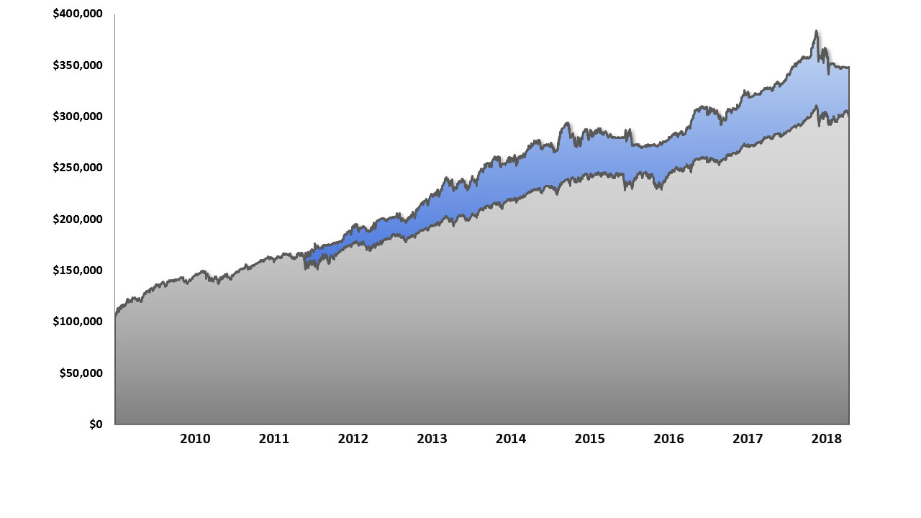
Since the market lows of March 9, 2009, the STATIC 60/40 portfolio* would have generated an annual return of +12.62% per year, but the Dynamic Risk Managed Example Portfolio** would have returned +14.34% per year.
Dynamic Risk Managed Example** +14.34%/yr.
STATIC 60/40*
+12.62%/yr.
STATIC 60/40 Portfolio* vs.
Dynamic Risk Managed Example Portfolio**
March 10, 2009 – June 29, 2018
The STATIC 60/40 Portfolio consists of a 60% allocation to the S&P Total Return Index, and a 40% allocation to the Barclays Aggregate Bond Index. The S&P 500 Total Return Index is the price return of the Standard & Poor's 500 Index, including daily reinvestment of dividends. It generally represents the aggregate price changes in the largest 500 US publicly traded companies, in addition to the reinvestment of the dividends that those companies pay. The Barclays US Aggregate Bond Index is a broad-based benchmark that measures the investment grade, US dollar-denominated, fixed-rate taxable bond market including Treasuries, government-related, corporate and other securities. ** The Dynamic Risk Managed Example Portfolio uses S&P 500 Total Return Index during "Positive" market conditions, and a group of three Bond sector ETFs during "Neutral" and "Negative" market conditions. The Bond sectors are selected by the Multi-Sector Bond Model published by The Sherman Sheet.TM Dividends are reinvested. Historical returns data has been compiled using price data provided by exchanges and not from actual accounts, and should therefore be considered to be hypothetical. Past performance is no guarantee of future results.
Notes:
After that, Dynamic Risk Management does better in the recovery years, as well.

Slide 25
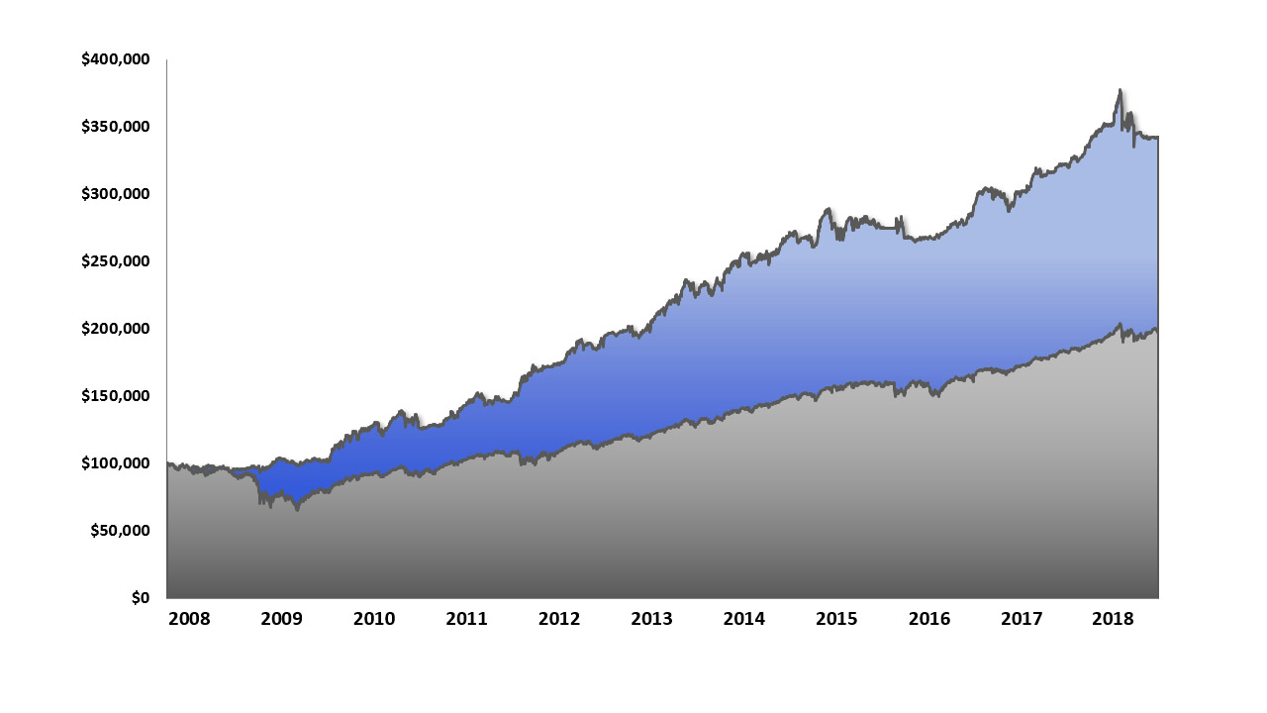
STATIC 60/40 Portfolio* vs.
Dynamic Risk Managed Example Portfolio**
October 7, 2007 – June 29, 2018
For the entire period spanning both the 2008-2009 bear market and the recovery that followed, we can see that the STATIC 60/40 portfolio* would have generated a return of +6.59% per year with a maximum loss of -34.70%, but the Dynamic Risk Managed Example Portfolio** would
have returned +12.15% per year
with a -11.16% maximum loss.
Dynamic Risk Managed Example** +12.15%/yr.
ENDING VALUE $100,000 INITIAL INVESTMENT
$342,181.02
STATIC 60/40*
+6.59%/yr.
ENDING VALUE $100,000 INITIAL INVESTMENT
$198,197.00
The STATIC 60/40 Portfolio consists of a 60% allocation to the S&P Total Return Index, and a 40% allocation to the Barclays Aggregate Bond Index. The S&P 500 Total Return Index is the price return of the Standard & Poor's 500 Index, including daily reinvestment of dividends. It generally represents the aggregate price changes in the largest 500 US publicly traded companies, in addition to the reinvestment of the dividends that those companies pay. The Barclays US Aggregate Bond Index is a broad-based benchmark that measures the investment grade, US dollar-denominated, fixed-rate taxable bond market including Treasuries, government-related, corporate and other securities. ** The Dynamic Risk Managed Example Portfolio uses S&P 500 Total Return Index during "Positive" market conditions, and a group of three Bond sector ETFs during "Neutral" and "Negative" market conditions. The Bond sectors are selected by the Multi-Sector Bond Model published by The Sherman Sheet.TM Dividends are reinvested. Historical returns data has been compiled using price data provided by exchanges and not from actual accounts, and should therefore be considered to be hypothetical. Past performance is no guarantee of future results.
Notes:
The benefit of losing less in the Bear + making more in the Bull, is readily-apparent when you add them together: All the money NOT LOST in the Bear would compound during the following years, creating a huge differential in the amount of money an investor potentially ends-up with.

Slide 26

To this point, the subject has been how
Dynamic Risk Management can dramatically
improve the ACCUMULATION phase of your
investment journey.

Slide 27

But how does it affect the DISTRIBUTION phase?

Slide 28
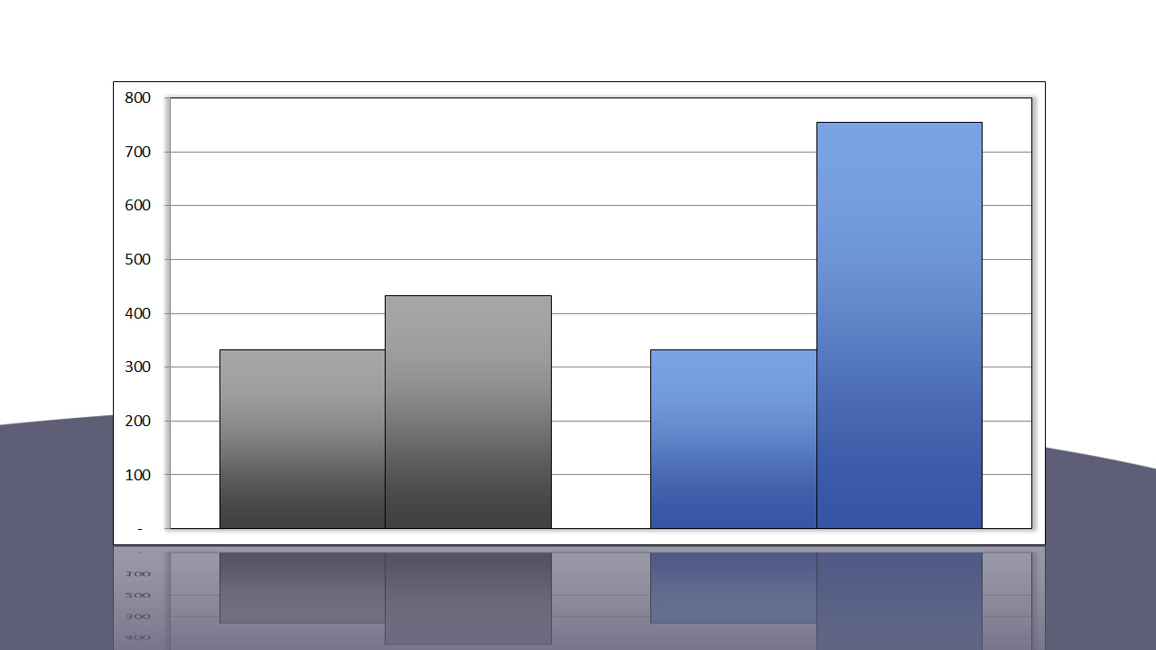
Monthly Withdrawal Amounts @ 4% per year per $100,000
October 2007 – June 2018
4%
annual
withdrawal
(distributed
monthly)
END
$756/month
END
$433/month
START
$333/month
START
$333/month
STATIC 60/40*
Dynamic Risk
Managed Example**
The STATIC 60/40 Portfolio consists of a 60% allocation to the S&P Total Return Index, and a 40% allocation to the Barclays Aggregate Bond Index. The S&P 500 Total Return Index is the price return of the Standard & Poor's 500 Index, including daily reinvestment of dividends. It generally represents the aggregate price changes in the largest 500 US publicly traded companies, in addition to the reinvestment of the dividends that those companies pay. The Barclays US Aggregate Bond Index is a broad-based benchmark that measures the investment grade, US dollar-denominated, fixed-rate taxable bond market including Treasuries, government-related, corporate and other securities. ** The Dynamic Risk Managed Example Portfolio uses S&P 500 Total Return Index during "Positive" market conditions, and a group of three Bond sector ETFs during "Neutral" and "Negative" market conditions. The Bond sectors are selected by the Multi-Sector Bond Model published by The Sherman Sheet.TM Dividends are reinvested. Historical returns data has been compiled using price data provided by exchanges and not from actual accounts, and should therefore be considered to be hypothetical. Past performance is no guarantee of future results.
Notes:
Beginning in October, 2007, a widely-recommended 4%/year withdrawal rate would result in dramatically-different outcomes when comparing Static Risk Management with Dynamic Risk Management.
A 74.5% difference in the monthly withdrawal amount …

Slide 29
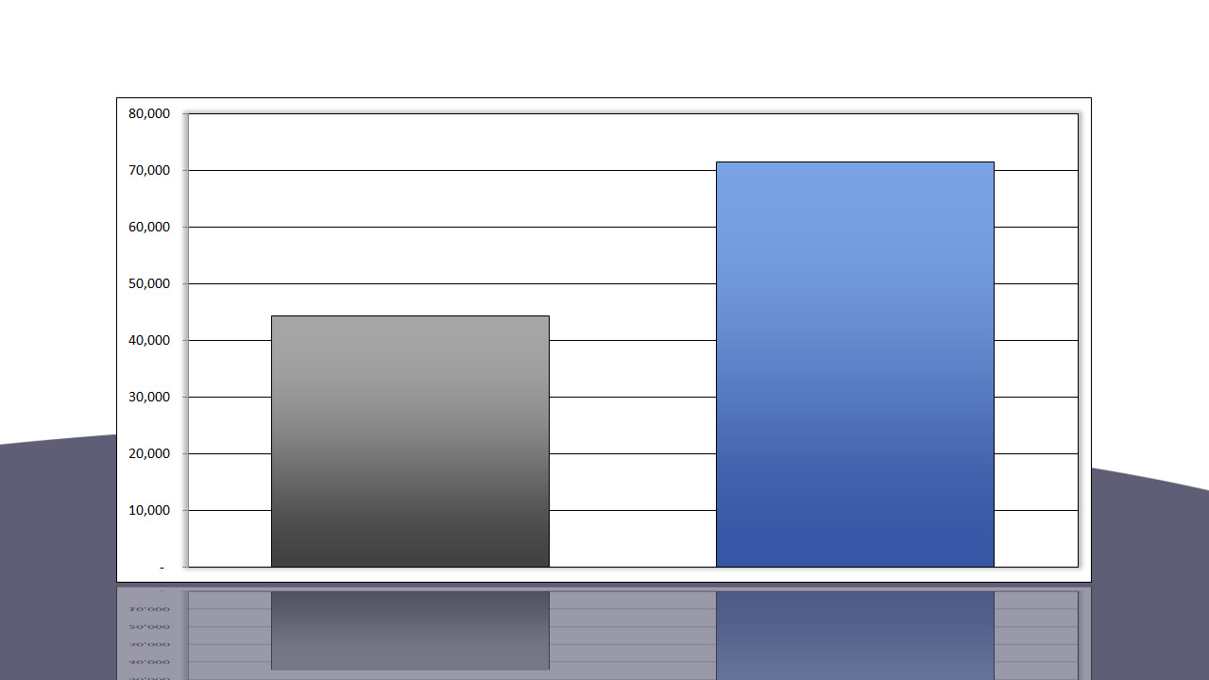
Total Withdrawn @ 4% per year per $100,000
October 2007 – June 2018
4%
annual
withdrawal
(distributed
monthly)
TOTAL WITHDRAWN
$71,521
TOTAL WITHDRAWN
$44,282
STATIC 60/40*
Dynamic Risk
Managed Example**
The STATIC 60/40 Portfolio consists of a 60% allocation to the S&P Total Return Index, and a 40% allocation to the Barclays Aggregate Bond Index. The S&P 500 Total Return Index is the price return of the Standard & Poor's 500 Index, including daily reinvestment of dividends. It generally represents the aggregate price changes in the largest 500 US publicly traded companies, in addition to the reinvestment of the dividends that those companies pay. The Barclays US Aggregate Bond Index is a broad-based benchmark that measures the investment grade, US dollar-denominated, fixed-rate taxable bond market including Treasuries, government-related, corporate and other securities. ** The Dynamic Risk Managed Example Portfolio uses S&P 500 Total Return Index during "Positive" market conditions, and a group of three Bond sector ETFs during "Neutral" and "Negative" market conditions. The Bond sectors are selected by the Multi-Sector Bond Model published by The Sherman Sheet.TM Dividends are reinvested. Historical returns data has been compiled using price data provided by exchanges and not from actual accounts, and should therefore be considered to be hypothetical. Past performance is no guarantee of future results.
Notes:
… a 61.5% greater total amount withdrawn …

Slide 30
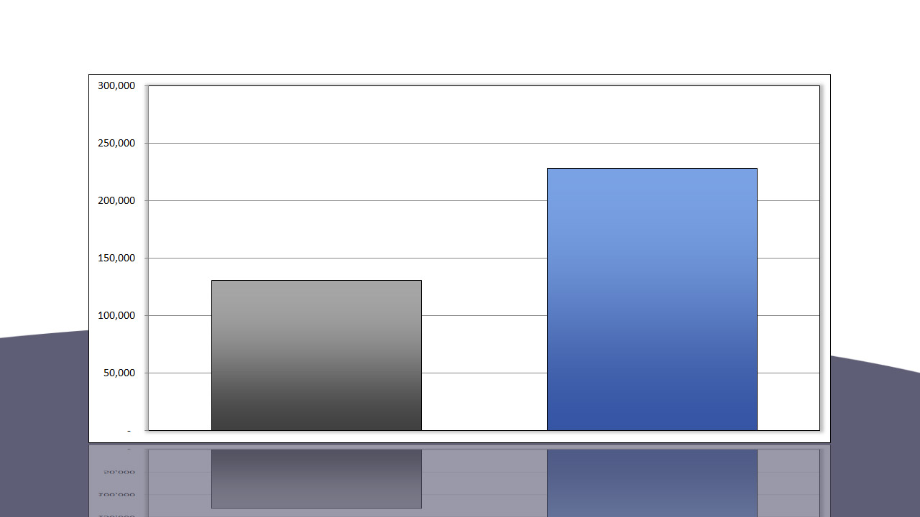
Ending Account Value @ 4% per year per $100,000
October 2007 – June 2018
4%
annual
withdrawal
(distributed
monthly)
ENDING ACCOUNT VALUE $228,193
ENDING ACCOUNT VALUE $130,680
STATIC 60/40*
Dynamic Risk
Managed Example**
The STATIC 60/40 Portfolio consists of a 60% allocation to the S&P Total Return Index, and a 40% allocation to the Barclays Aggregate Bond Index. The S&P 500 Total Return Index is the price return of the Standard & Poor's 500 Index, including daily reinvestment of dividends. It generally represents the aggregate price changes in the largest 500 US publicly traded companies, in addition to the reinvestment of the dividends that those companies pay. The Barclays US Aggregate Bond Index is a broad-based benchmark that measures the investment grade, US dollar-denominated, fixed-rate taxable bond market including Treasuries, government-related, corporate and other securities. ** The Dynamic Risk Managed Example Portfolio uses S&P 500 Total Return Index during "Positive" market conditions, and a group of three Bond sector ETFs during "Neutral" and "Negative" market conditions. The Bond sectors are selected by the Multi-Sector Bond Model published by The Sherman Sheet.TM Dividends are reinvested. Historical returns data has been compiled using price data provided by exchanges and not from actual accounts, and should therefore be considered to be hypothetical. Past performance is no guarantee of future results.
Notes:
… and a 74.6% greater ending account value!

Slide 31
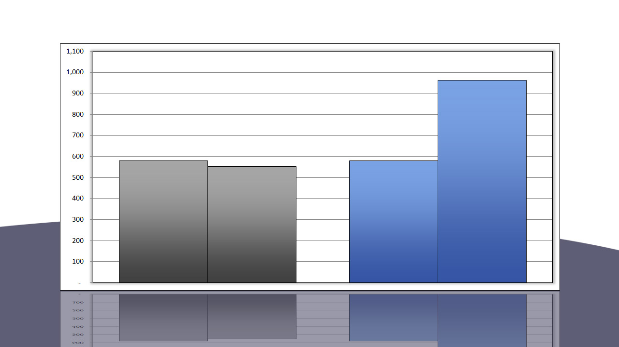
Monthly Withdrawal Amounts @ 7% per year per $100,000
October 2007 – June 2018
7%
annual
withdrawal
(distributed
monthly)
END
$963/month
START
$580/month
END
$551/month
START
$580/month
STATIC 60/40*
Dynamic Risk
Managed Example**
The STATIC 60/40 Portfolio consists of a 60% allocation to the S&P Total Return Index, and a 40% allocation to the Barclays Aggregate Bond Index. The S&P 500 Total Return Index is the price return of the Standard & Poor's 500 Index, including daily reinvestment of dividends. It generally represents the aggregate price changes in the largest 500 US publicly traded companies, in addition to the reinvestment of the dividends that those companies pay. The Barclays US Aggregate Bond Index is a broad-based benchmark that measures the investment grade, US dollar-denominated, fixed-rate taxable bond market including Treasuries, government-related, corporate and other securities. ** The Dynamic Risk Managed Example Portfolio uses S&P 500 Total Return Index during "Positive" market conditions, and a group of three Bond sector ETFs during "Neutral" and "Negative" market conditions. The Bond sectors are selected by the Multi-Sector Bond Model published by The Sherman Sheet.TM Dividends are reinvested. Historical returns data has been compiled using price data provided by exchanges and not from actual accounts, and should therefore be considered to be hypothetical. Past performance is no guarantee of future results.
Notes:
A more aggressive income withdrawal of 7%/year shows a similar improvement, but with one important difference: With Static Risk Management, the principal value is reduced (in other words, some of the income is taken from principal); with the Dynamic Risk Management example, the principal value continues to grow, “aggressive” withdrawals or no.

Slide 32
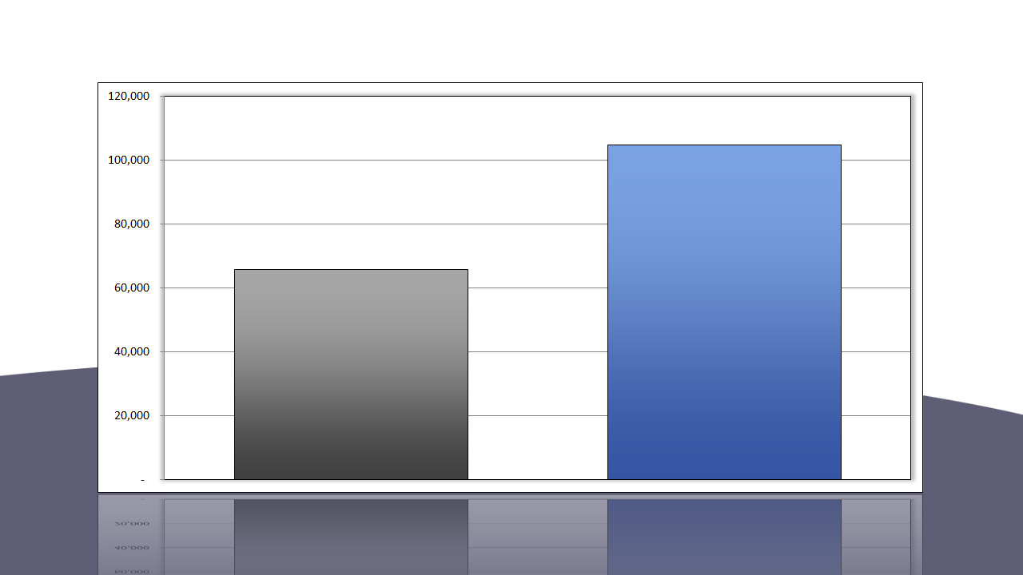
Total Withdrawn @ 7% per year per $100,000
October 2007 – June 2018
7%
annual
withdrawal
(distributed
monthly)
TOTAL WITHDRAWN
$104,708
TOTAL WITHDRAWN
$65,656
STATIC 60/40*
Dynamic Risk
Managed Example**
The STATIC 60/40 Portfolio consists of a 60% allocation to the S&P Total Return Index, and a 40% allocation to the Barclays Aggregate Bond Index. The S&P 500 Total Return Index is the price return of the Standard & Poor's 500 Index, including daily reinvestment of dividends. It generally represents the aggregate price changes in the largest 500 US publicly traded companies, in addition to the reinvestment of the dividends that those companies pay. The Barclays US Aggregate Bond Index is a broad-based benchmark that measures the investment grade, US dollar-denominated, fixed-rate taxable bond market including Treasuries, government-related, corporate and other securities. ** The Dynamic Risk Managed Example Portfolio uses S&P 500 Total Return Index during "Positive" market conditions, and a group of three Bond sector ETFs during "Neutral" and "Negative" market conditions. The Bond sectors are selected by the Multi-Sector Bond Model published by The Sherman Sheet.TM Dividends are reinvested. Historical returns data has been compiled using price data provided by exchanges and not from actual accounts, and should therefore be considered to be hypothetical. Past performance is no guarantee of future results.
Notes:
At a 7% monthly withdrawal rate, the total amount withdrawn using the Dynamic Risk Managed Example is 59.4% greater …

Slide 33
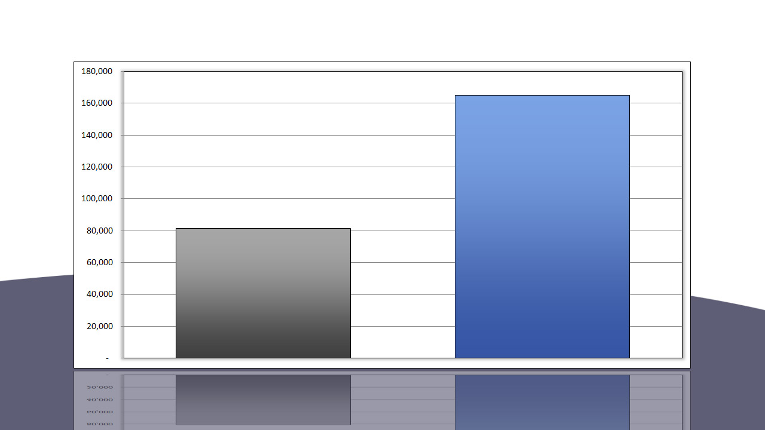
Ending Account Value @ 7% per year per $100,000
October 2007 – June 2018
7%
annual
withdrawal
(distributed
monthly)
ENDING ACCOUNT VALUE $165,044
ENDING ACCOUNT VALUE $81,355
STATIC 60/40*
Dynamic Risk
Managed Example**
The STATIC 60/40 Portfolio consists of a 60% allocation to the S&P Total Return Index, and a 40% allocation to the Barclays Aggregate Bond Index. The S&P 500 Total Return Index is the price return of the Standard & Poor's 500 Index, including daily reinvestment of dividends. It generally represents the aggregate price changes in the largest 500 US publicly traded companies, in addition to the reinvestment of the dividends that those companies pay. The Barclays US Aggregate Bond Index is a broad-based benchmark that measures the investment grade, US dollar-denominated, fixed-rate taxable bond market including Treasuries, government-related, corporate and other securities. ** The Dynamic Risk Managed Example Portfolio uses S&P 500 Total Return Index during "Positive" market conditions, and a group of three Bond sector ETFs during "Neutral" and "Negative" market conditions. The Bond sectors are selected by the Multi-Sector Bond Model published by The Sherman Sheet.TM Dividends are reinvested. Historical returns data has been compiled using price data provided by exchanges and not from actual accounts, and should therefore be considered to be hypothetical. Past performance is no guarantee of future results.
Notes:
… and the ending account value of the Dynamic Risk Managed Example is 102% greater.

Slide 34

“The stock market is a device for transferring money from the impatient to the patient.”
~ Warren Buffett
Notes:
Dynamic Risk Management requires patience, and a good understanding of the principles of successful investing. But the reward is ample! As Warren Buffett says, “The stock market is a device for transferring money from the impatient to the patient!”

Slide 35

Disaster Avoidance is no Accident
More than a catchy phrase, “Disaster Avoidance” requires a disciplined, structured methodology to achieve what should be the goal of every financial advisor: to shepherd their clients on a survivable journey, leading to the achievement of their retirement dreams.
Our implementation of Dynamic Risk Management is that methodology.
The industry-standard 60/40 portfolio imposes losses that are unacceptably high, and gains that are unnecessarily low. Dynamic Risk Management seeks to significantly improve on both.
Notes:
In summary, "Disaster Avoidance is No Accident" is not just a slogan for us - it is a way of life. This presentation shows how the concept of Dynamic Risk management addresses the shortfalls of the industry-standard Static Risk management, with a potentially far superior outcome, to achieve our goal of "Disaster Avoidance"!

Slide 36
Q&A
Notes:
In summary, "Disaster Avoidance is No Accident" is not just a slogan for us - it is a way of life. This presentation showed how the concept of Dynamic Risk management addresses the shortfalls of the industry-standard Static Risk management, with a potentially far superior outcome, to achieve our goal of "Disaster Avoidance"!

Slide 37
DISCLAIMER
The opinions voiced in this material are for general information only and are not intended to provide or be construed as providing specific investment advice or recommendations for any individual. To determine which investments may be appropriate for you, consult your financial advisor prior to investing. All performance referenced is historical and is no guaranteed of future results. All indices are unmanaged and cannot be invested in directly.
This information is not intended to be a substitute for specific individualized tax advice. We suggest that you discuss your specific tax issues with a qualified tax advisor.
Not FDIC/NCUA Insured | Not Bank/Credit Union Guaranteed | May Lose Value | Not Guaranteed by any Government Agency | Not a Bank/Credit Union Deposit.
Optimum Wealth Management, LLC
Dynamic Risk Management may involve more frequent buying and selling of assets and will tend to generate higher transaction costs. Investors should consider the tax consequences of moving positions more frequently.
Registered Contact Information:
Michael C. Cordak
Optimum Wealth Management, LLC
2033 Cresthaven Walk Woodstock, GA 30189
678-778-2694

